Slide 1


Team Fantastic 4
Ahana Mukherjee
Naren Jhabakh
Shantaram Parab
Zeeshan Khatib

Slide 2
Problem statement
Why is it an interesting problem to pursue?
Metadata unavailable
Site grouping based on consumption profile
What is a probable solution?
Analyze consumption data
Our Hypothesis: exploit operating schedules of each site

Slide 3
Methodology
Data Processing
Feature Extraction
Classification
Performance Analysis

Slide 4
Data Processing/Assumptions
Used IPython, pandas, numpy, sklearn, matplotlib and plotly
Aggregated the meters readings with sites having multiple meters
Changed the time reference to local from UTC.
Backfilled Nan values.
Classification based on Industry, given the sparseness of the dataset.

Slide 5
Feature Extraction
Weekday/Weekend ratio
Max(95th percentile)/Mean Annual demand.
Unoccupied/Occupied demand.
Fast Fourier Transform (fft) – Bench Marking (52, 104,260,365) +/- 10 days.
Time-Zone(Location)

Slide 6
Classification & Results
Random Forests
Naïve Bayes
Method | Random Forest | Naïve Bayes
Accuracy | ~ 65% | ~ 50%

Slide 7
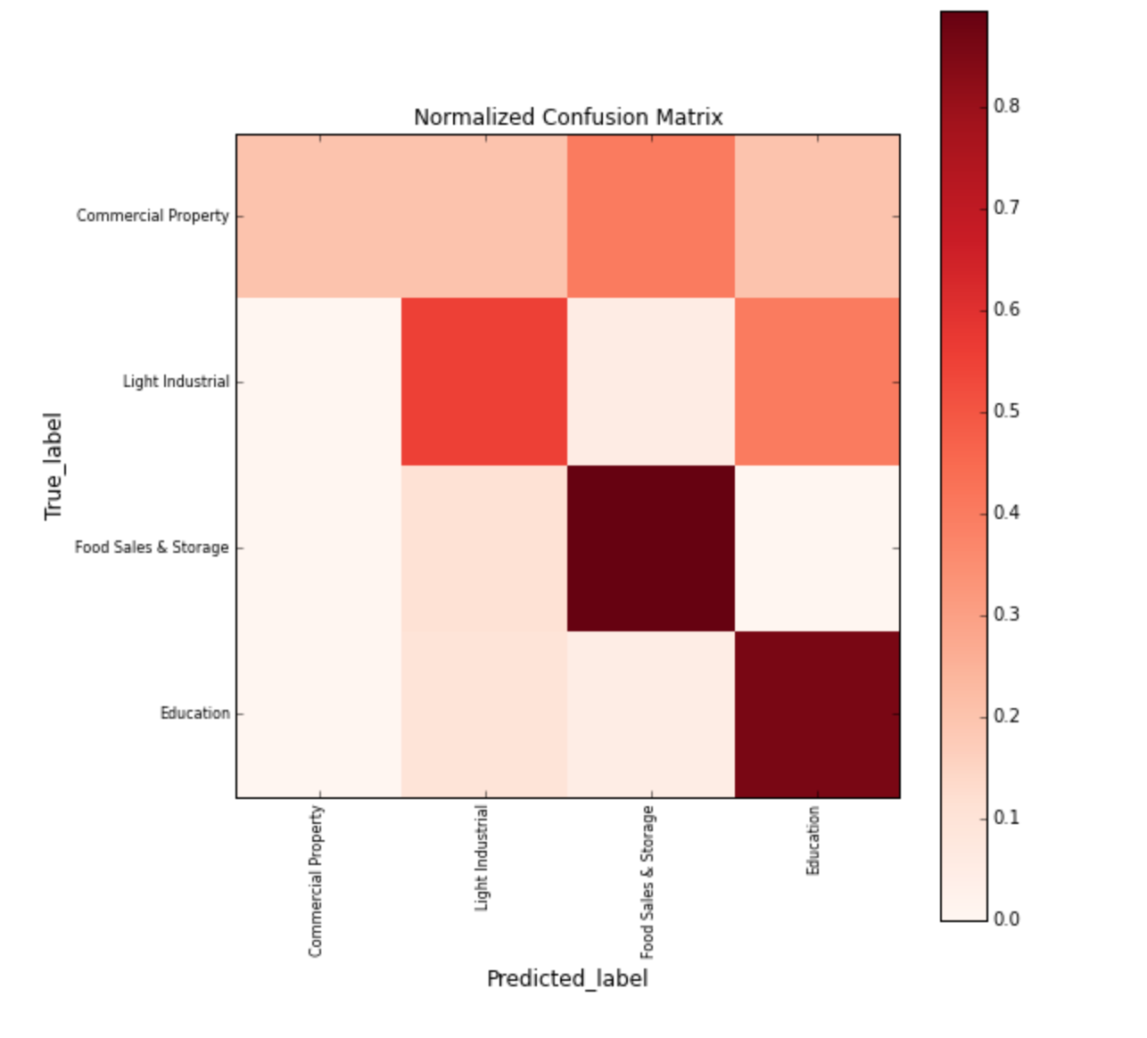
Performance Measure
Confusion Matrix

Slide 8
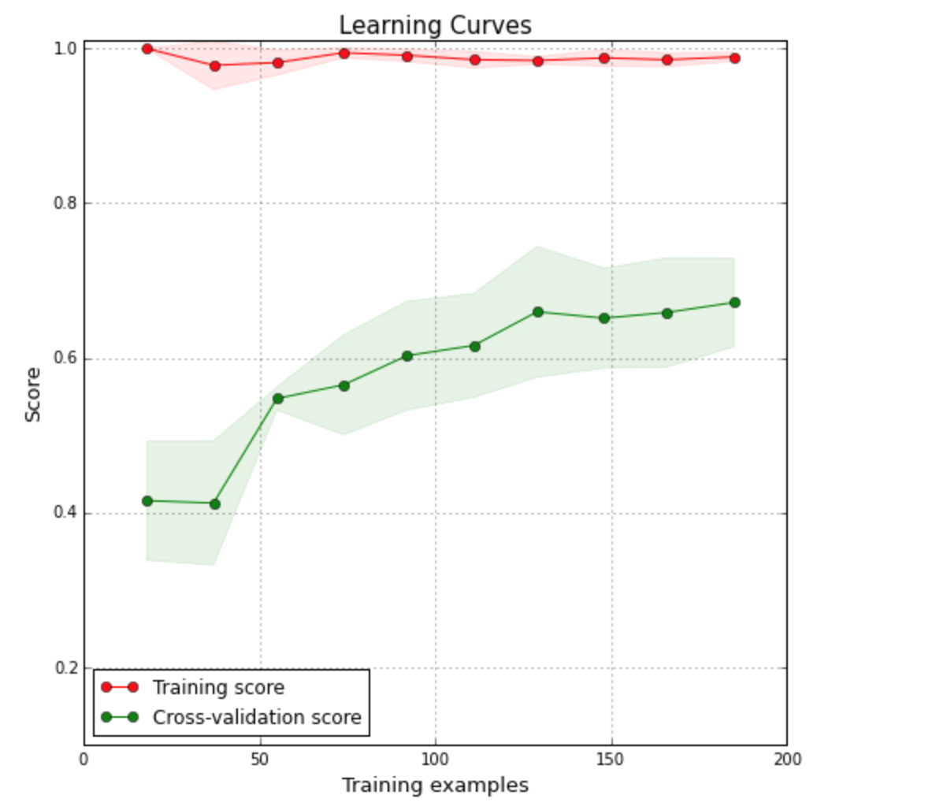
Performance Measure
Learning rate

Slide 9
Conclusions

Slide 10
Thank You !
Questions?

